Slide 1
Installation of Talend Data Catlog on linux server
Preparing your installation
# Files to download:-
1) The software package
2) The license file
#The link will show the compatible requirements to install TDC
https://help.talend.com/r/en-US/8.0/data-catalog-installation-and-upgrade-guide-windows/files-to-download

Slide 2
#Install compatible java version
cd /usr/lib
mkdir jvm
chmod -R 777 jvm
wget https://www.oracle.com/in/java/technologies/javase/jdk11-archive-downloads.html#license-lightbox
#extract the java file
tar -xvf jdk-11.0.17-linux-x64.tar.gz
#set the java path
cd /etc/profile.d
sudo vi jdk.sh
export JAVA_HOME=/usr/lib/jvm/jdk-11.0.18
export JRE_HOME=//usr/lib/jvm/jdk-11.0.18/jre (if jre is not in bin then remove the line)
export PATH=$JAVA_HOME/bin:$JRE_HOME/bin:$PATH

Slide 3
Installation of TDC
Software is available at https://www.opensourceetl.net/TalendDataCatalog
username: datacatalog
password: eu5bIR95mNZWmQHs6NCl
#goto latest version 8.0
#goto software packages
Installation of TDC-8-20230227.tbz2 file
cd /opt
mkdir TDC
cd /opt/TDC
#wget --user=datacatalog --ask-password http://www.opensourceetl.net/TalendDataCatalog/8.0/Software/TDC-8-20230227.tbz2
#sudo yum install bzip2
#tar xjvf TDC-8-20230223.tbz2

Slide 4
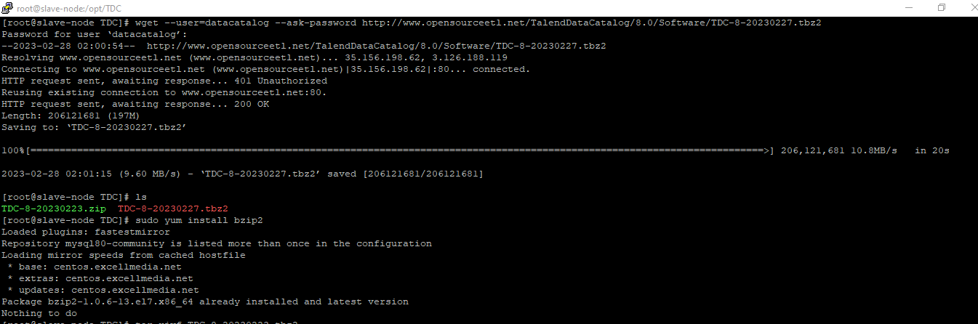

Slide 5
Cd /opt/TDC/TalendDataCatlog
# run the following command
./Setup.sh --tomcat-port 11480 --tomcat-agent false --tomcat-service true --ssl false
# Then Restart the TDC
./RestartServerApplication.sh

Slide 6
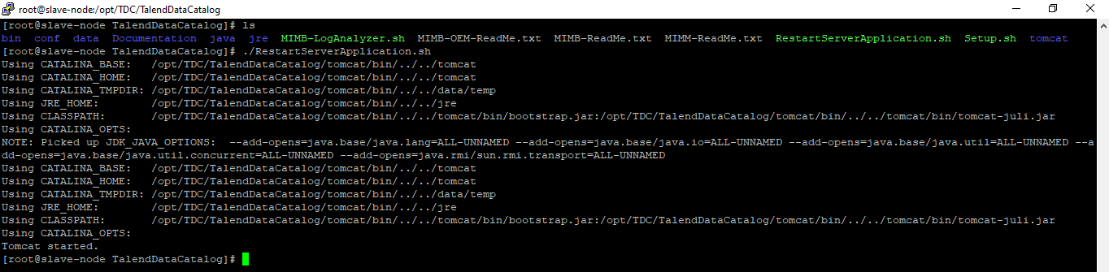

Slide 7
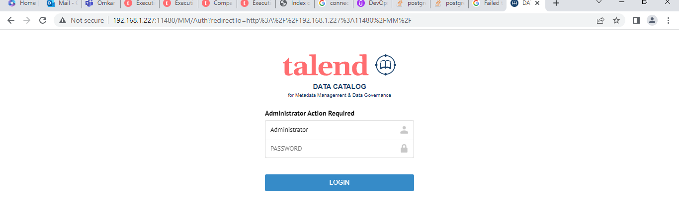
#Run the ip address and port on the browser
192.168.1.227:11480
Username :- Administrator
Password :- Administrator

Slide 8
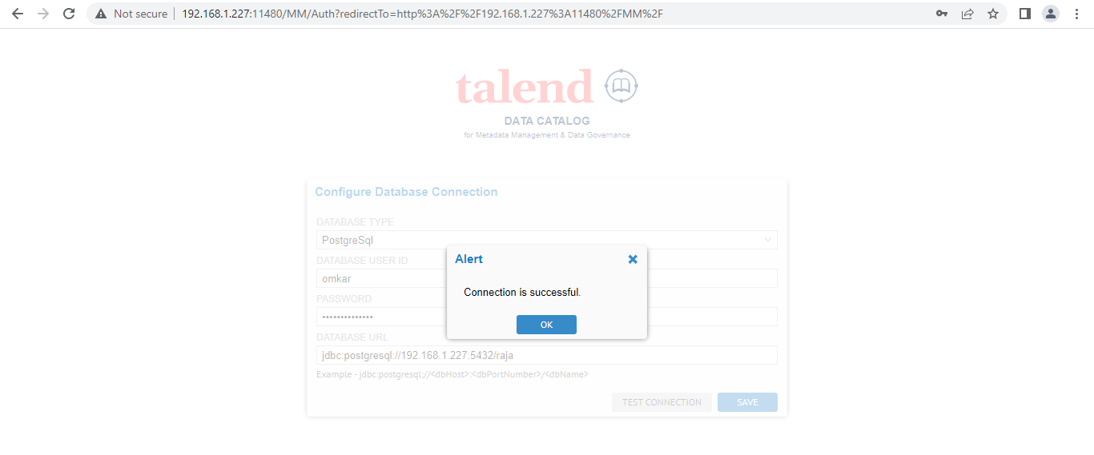
#configure all the database information and connect the database
Select the database type:-
Username:-
Password:-
jdbc:postgresql://<ip-address>:5432/<database-name>
#Test the connection and save it
#once again login by using username and password.

Slide 9
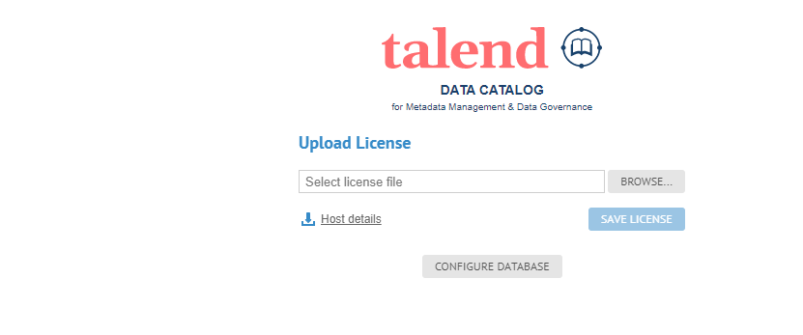
#upload a license file that you have
#Download the Host Details file
#Upload the Host details file in the URL provided with mail
It will generate the license
#Browse and Upload the license file and save it.

